Slide 1
Algorithm Development and Control Statements: Part 1
C++ How to Program, 10/e

Slide 2
4.1 Introduction
Before writing a program to solve a problem, have a thorough understanding of the problem and a carefully planned approach to solving it.
Understand the available building blocks and employ proven program-construction techniques.

Slide 3
4.2 Algorithms
Any solvable computing problem can be solved by the execution a series of actions in a specific order.
An algorithm is a procedure for solving a problem in terms of
the actions to execute and
the order in which these actions execute
Specifying the order in which statements (actions) execute in a computer program is called program control.
This chapter investigates program control using C++’s control statements.

Slide 4
4.3 Pseudocode
Pseudocode (or “fake” code) is an artificial and informal language that helps you develop algorithms.
Similar to everyday English
Helps you “think out” a program before attempting to write it.
Carefully prepared pseudocode can easily be converted to structured portions of C++ programs.
Normally describes only executable statements.
Declarations (that do not have initializers or do not involve constructor calls) are not executable statements.
Fig. 4.1 corresponds to the algorithm that inputs two integers from the user, adds these integers and displays their sum.

Slide 5
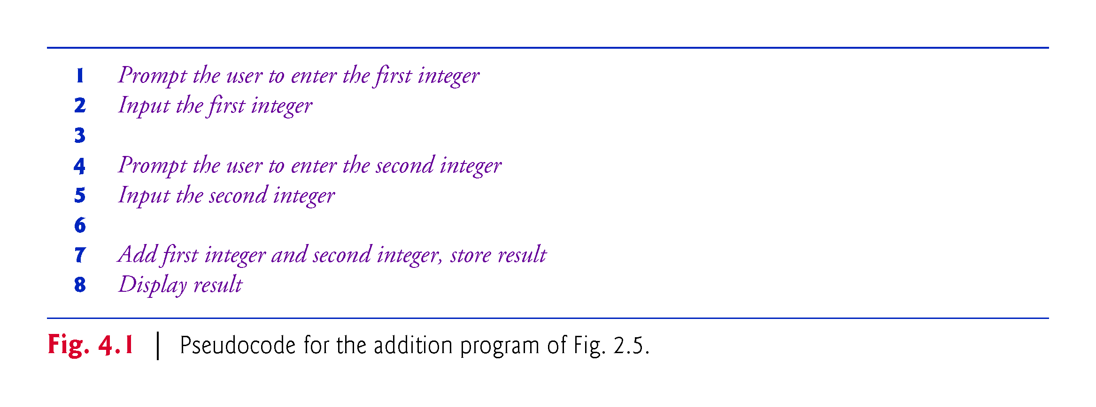

Slide 6
4.4 Control Structures
Normally, statements in a program are executed one after the other in the order in which they’re written.
Called sequential execution.
Various C++ statements enable you to specify that the next statement to execute may be other than the next one in sequence.
Called transfer of control.
All programs could be written in terms of only three control structures
the sequence structure
the selection structure and
the iteration structure
When we introduce C++’s implementations of control structures, we’ll refer to them in the terminology of the C++ standard document as “control statements.”

Slide 7
4.4.1 Sequence Structure
Unless directed otherwise, the computer executes C++ statements one after the other in the order in which they’re written—that is, in sequence.
The Unified Modeling Language (UML) activity diagram of Fig. 4.2 illustrates a typical sequence structure in which two calculations are performed in order.

Slide 8
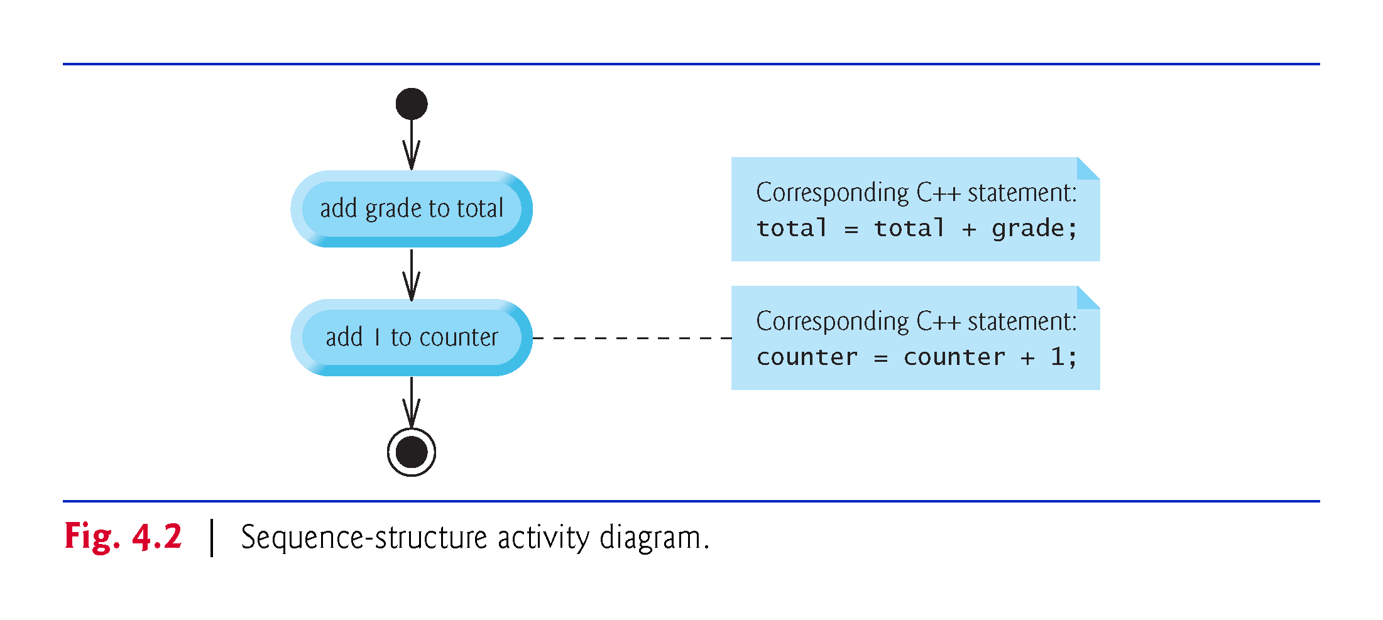

Slide 9
4.4.1 Sequence Structure
An activity diagram models the workflow (also called the activity) of a portion of a software system.
Activity diagrams are composed of special-purpose symbols, such as
Action state symbols (rectangles with their left and right sides replaced with arcs curving outward). They represent actions to perform.
Diamonds. They represent decisions.
Small circles. They represent the initial and final states.
Transition arrows. They represent the flow of the activity.
In addition, there are often
Rectangles with the upper-right corners folded over. They are used for explaining action state symbols.

Slide 10
4.4.2 Selection Statements
C++ has three types of selection statements (discussed in this chapter and Chapter 5).
The if selection statement either performs (selects) an action (or group of actions) if a condition (predicate) is true or skips the action (or group of actions) if the condition is false.
The if…else selection statement performs an action (or group of actions) if a condition is true or performs a different action (or group of actions) if the condition is false.
The switch selection statement (Chapter 5) performs one of many different actions (or groups of actions), depending on the value of an integer expression.

Slide 11
4.4.2 Selection Statements
Syntax for if statements:
if (condition)
action;
Or if there are several actions,(or only one but for clarity):
if (condition)
{ action1;
action1;
}

Slide 12
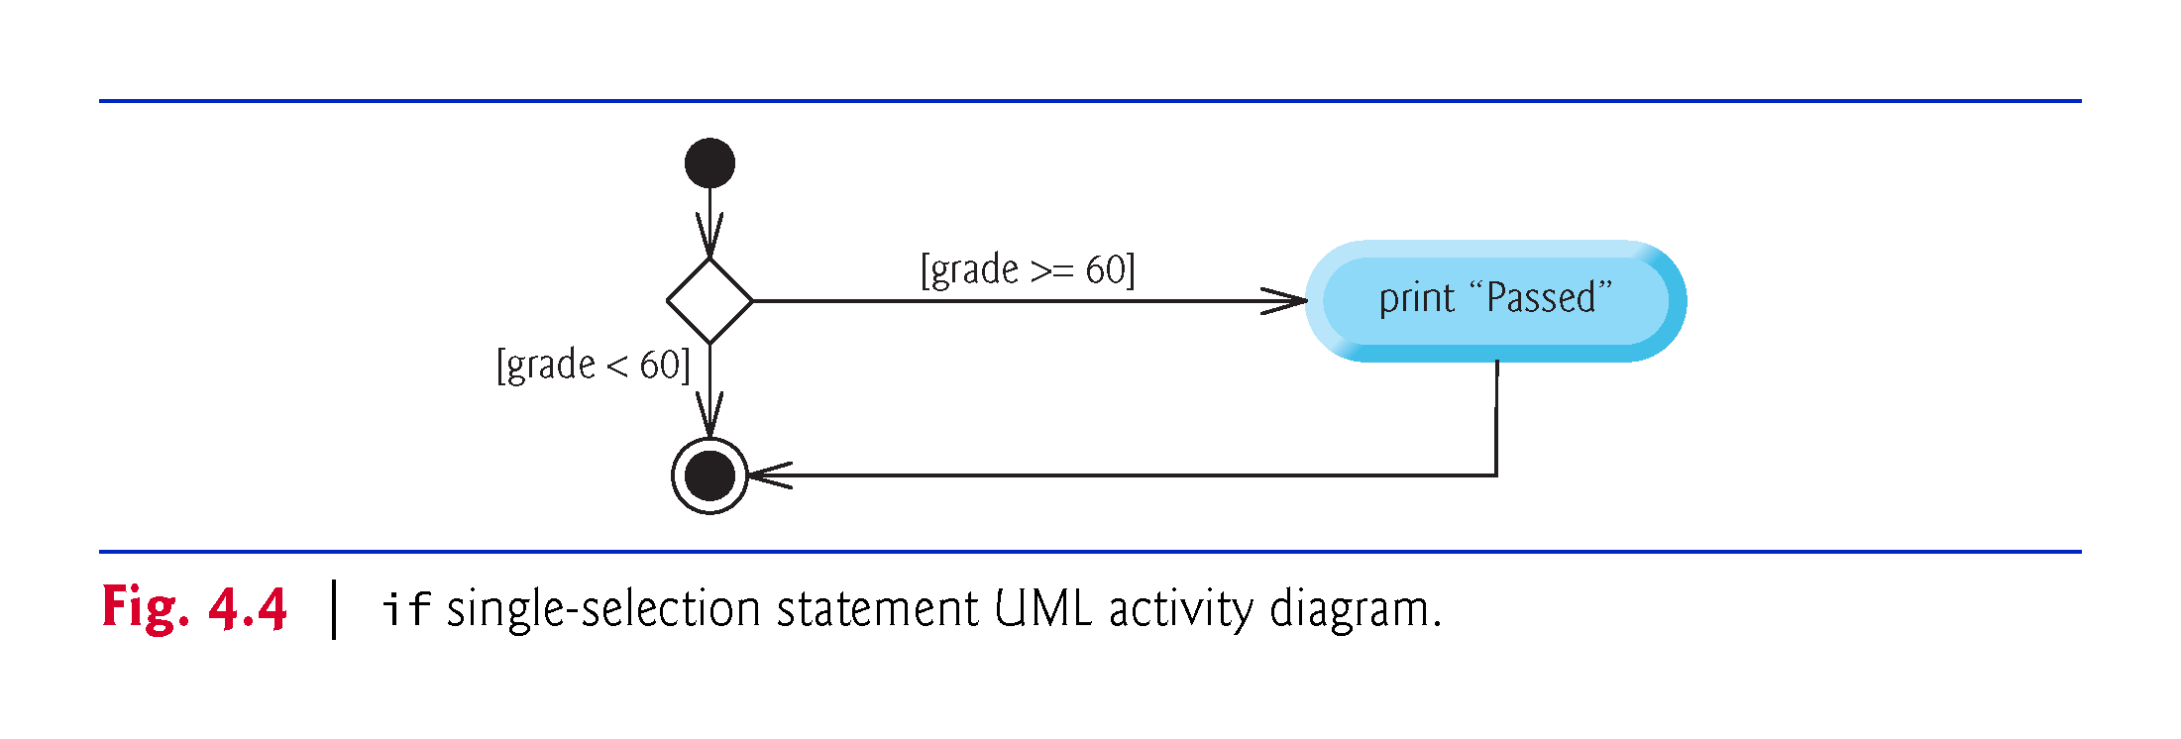
if (grade >= 60)
{
cout << "Passed";
}

Slide 13
Simple if Demo
Write a program that prompts the user to enter an integer. If the number is a multiple of 5, print HiFive. If the number is divisible by 2, print HiEven.
int main() { cout << "Enter an integer: “; int number;
cin >> number; if (number % 5 == 0) cout <<"HiFive"; if (number % 2 == 0) cout << "HiEven“; }
Enter an interger
5
Hi five
Enter an integer: 30 HiFive HiEven

Slide 14
4.4.2 Selection Statements
Syntax for if—else statements:
if (condition)
action1;
else
action2;
Or as before, if there are several actions, or for clarity:
if (condition)
action1;
else
{
action2;
action2;
}

Slide 15
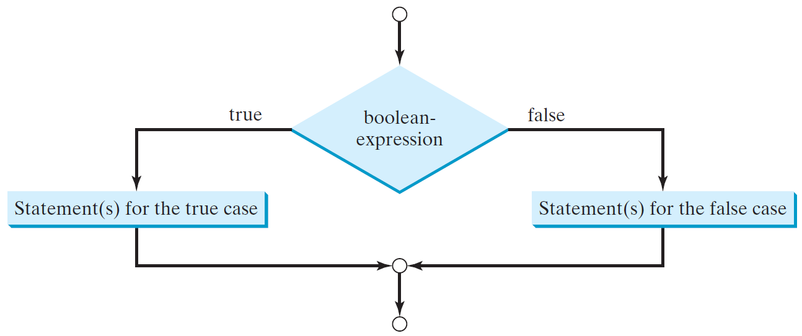
The Two-way if Statement
if (boolean-expression) {
statement(s)-for-the-true-case;
}
else {
statement(s)-for-the-false-case;
}

Slide 16
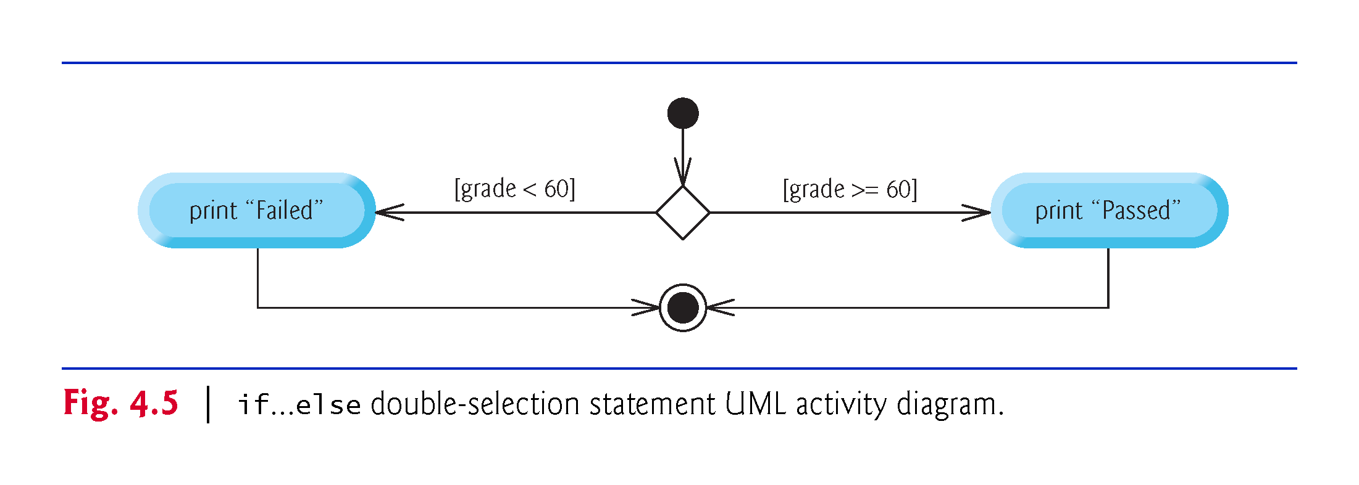
if (grade >= 60)
{
cout << "Passed";
}
else
{
cout << "Failed";
}

Slide 17
4.4.2 Selection Statements
Write a program in which the user enters a number grade and it returns “Pass” if the grade is 60 or more and “Fail” if the grade is less than 60.
Modify the program so that it returns the letter grade corresponding to the number grade:
F if the number grade is less than 60.
D if the number grade is between 60 and 69, both inclusive.
C if the number grade is between 70 and 79, both inclusive.
B if the number grade is between 80 and 89, both inclusive.
A if the number grade is between 90 and 100, both inclusive.

Slide 18
Multiple Alternative if Statements

Slide 19
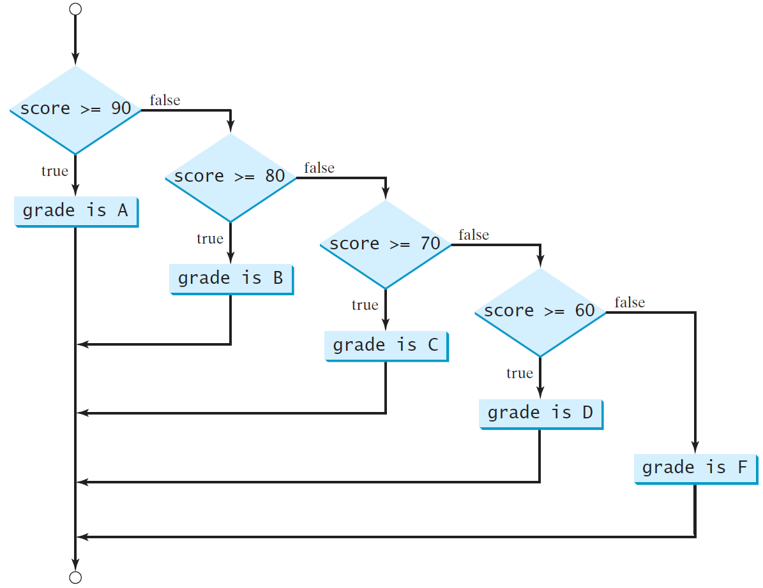
Multi-Way if-else Statements

Slide 20
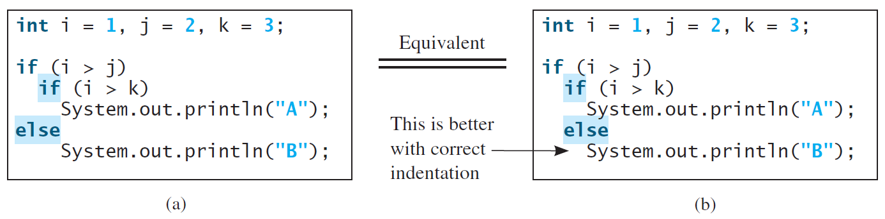
Note
The else clause matches the most recent if clause in the same block.

Slide 21
Common Errors
Adding a semicolon at the end of an if clause is a common mistake.
if (radius >= 0);
{
area = radius*radius*PI;
cout<<"The area for the circle of radius " <<
radius << " is " << area;
}
This mistake is hard to find, because it is not a compilation error or a runtime error, it is a logic error.
This error often occurs when you use the next-line block style.
Wrong

Slide 22
CAUTION

